Slide 1

Online Grocery Store System

Slide 2
Agenda
Introduction
Technology Stack
System Architecture
Module Functionalities
Database Schema
Advantages
Conclusion

Slide 3

Introduction
Develop a web-based Online Grocery Store for customers to browse, purchase, and manage grocery items.
The system supports customers in searching for products, placing orders, and tracking deliveries.
Administrators can manage inventory, process orders, and monitor customer activity.

Slide 4
Technology Stack
Front-End: Angular
Server-side: Spring Boot.
Back-end: MYSQL, Hibernate.
Server: Tomcat

Slide 5
System Architecture
Customer Portal: User interface for customers to interact with the store.
Administrator Dashboard: Backend for administrators to manage store operations.
Delivery Personnel Dashboard: Tools for delivery personnel to handle deliveries.

Slide 6
Customer Portal Features
Functionalities
Browse Products: Search by category, price, or keywords; view product details.
Add to Cart & Checkout: Add items to cart, review, and select delivery options.
Order History & Tracking: View past orders and track current ones with notifications.
Profile Management: Update personal info, delivery address, and payment methods.

Slide 7
Administrator Dashboard Features
Functionalities
Product Management: Add, update, or remove products; manage prices and stock levels.
Order Management: Process and track customer orders; assign to delivery personnel.
Sales & Reports: Generate sales and inventory reports.
Customer Support: Handle inquiries, issues, or complaints.

Slide 8
Delivery Personnel Dashboard Features
Functionalities
View Assigned Deliveries: Access delivery list with customer details.
Update Delivery Status: Mark as “Out for Delivery,” “Delivered,” or “Failed.”
Track Routes: Use map/GPS to optimize delivery routes.

Slide 9
Admin Dashboard Features
Functionalities
User Role Management: Manage user accounts, roles, and permissions.

Slide 10
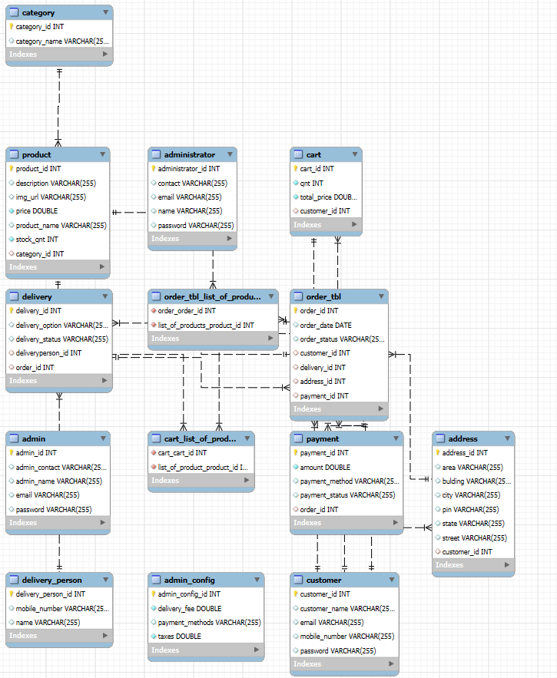
Database Schema

Slide 11
Advantages
Customer Convenience: Seamless shopping experience with easy navigation and order tracking.
Efficient Management: Streamlines inventory, order processing, and customer support.
Optimized Deliveries: Enables efficient management and tracking of delivery routes.

Slide 12
Conclusion
Summary
The Online Grocery Store aims to revolutionize grocery shopping by integrating advanced functionalities.
Provides a user-friendly interface for customers, administrators, and delivery personnel.
Ensures efficient operations and high customer satisfaction.

Slide 13

Thank You

